Slide 1

Budget Update
January 13, 2021

Slide 2

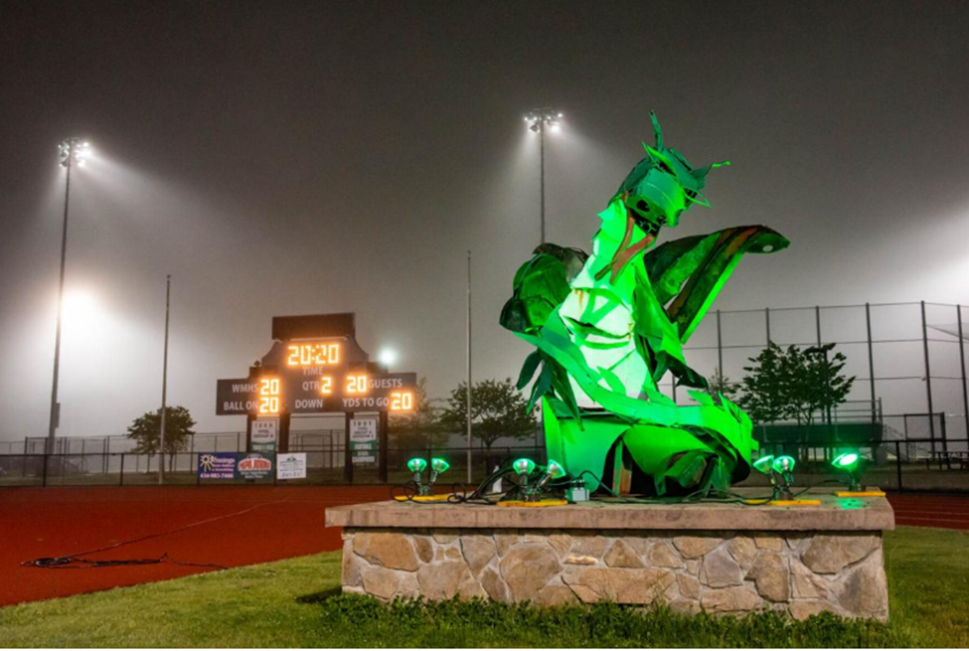
VISION
Empowering our community’s children for life-long success.

Slide 3
MISSION
Innovate
Engage
Succeed
Engage all students through learning that is innovative, personalized, and relevant.

Slide 4
Greene County School
Board Priorities
2020-2021
Support the implementation of Innovate 2021 including our core values of innovation and academic excellence; providing a safe and supportive learning environment; efficient utilization of resources; and collaboration and communication with all stakeholders.
Provide competitive compensation and benefits for all staff.
Focus on the support, recruitment, and retention of the most highly qualified educators, leaders, and support staff.

Slide 5
Local Budget Process
January
1/13 | School Board Meeting Discuss needs Identify priorities to move forward
1/27 | School Board Budget Work Session Draft budget proposal
TBD | School Board/Board of Supervisors Workshop
February
2/10 | School Board Meeting Public hearing on budget proposal
2/24 | School Board Budget Adoption

Slide 6
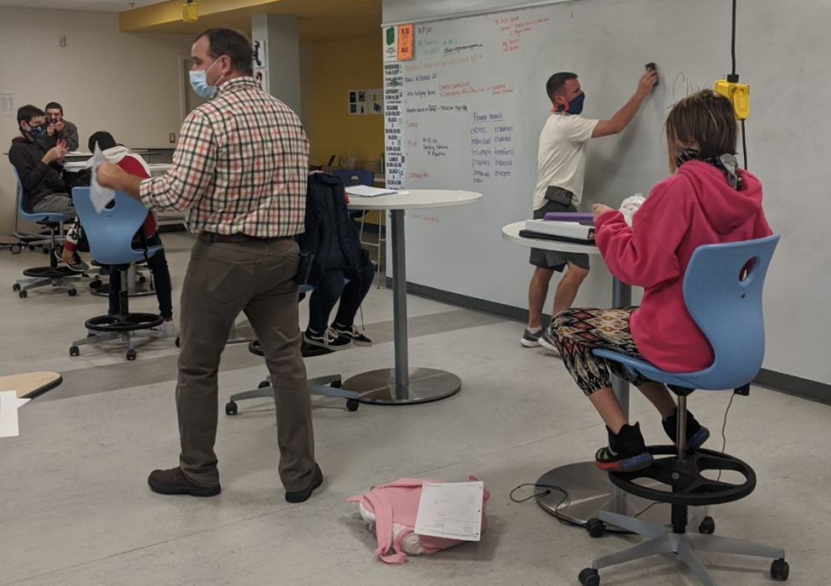
Virginia code mandates that it is the duty of the Superintendent to prepare a budget with an estimate of the amount of money deemed to be needed to support the school division. This is commonly referred to as a “needs -based budget.”
These numbers reflect preliminary, broad estimates and are to illustrate potential revenue and expenditures only.
The total of the potential expenditures should not be interpreted as a recommended change to the budget.

Slide 7
FY 2022 Influencing Factors
Enrollment
  FY 21 – 2868* vs 2892 used for Budget Planning
  FY 22 – Projecting 2875
    *Based on current enrollment less regional program students
VRS
  2nd year of new biennium – rate stays flat at 19.17%
Local Composite Index (LCI)
    2nd year of biennium 2020-2022 – flat at .3446
Operating Expense
  Fuel rates and vehicle maintenance costs are expected to be flat. Utilities are being surveyed for rate changes. Any fluctuations will be offset within existing budget structure. Building Insurance expected to remain flat.
COVID Impact
  Increased need for student supports
  Learning loss
  Operating mode still unknown, potential spatial constraints

Slide 8
Revenues – State
Fiscal Year | State Budget | Budget ADM
FY 2021 | $20,036,386 | 2848.85 *
FY 2022 | $20,427,176 | 2875 ◊
From Governor’s Budget Proposal of 12/16/20. GCPS approved FY 21 State budget funding was $20,030,630 based on 2922 ADM in December 2019
State ADM projection was 2833.05. GCPS projection includes revised count based on changes in returning student count and potentially larger kindergarten enrollment.
Considerations
House and Senate still to present their versions of budget bills
Governor’s proposal includes updates to sales tax and lottery revenue estimates and considerations for funding impacts relating to the pandemic.
Restoration of categorical funding tied to specific, dedicated mandates
  Mandates on Staffing – School Counselors
  Preschool and Early Childhood Education
  Presumptive English Learners
  No loss funding
Funding in FY 22 for a 2% bonus and only for SOQ positions. May change to a raise in House and Senate versions. Must be given by 9/1/2021.

Slide 9
Revenues – Federal
Federal Budget
FY 2021 Federal Revenue Budget | $2,080,000
Actual FY20 Fed Revenue Received | $1,991,900
Difference | $88,100 | FY 22 estimate $2,080,000
Estimating flat funding based on assumption of flat enrollment. Federal funds cover only program eligible expenses such as Federal Title Programs and School Nutrition.
Considerations
All Federal revenues are specifically mandated by program and cannot be allocated outside of the program for which they are approved.
Each program specifies how the funding can be used categorically, and in some cases it may exclude specific categories for expenditures.
Year over year funding may change based on the federal application and can include non-recurring expenses.
Program specifications and mandates fluctuate from year to year affecting available funding and allocations.
Funding can be revised by the government during/within the active budget year.

Slide 10
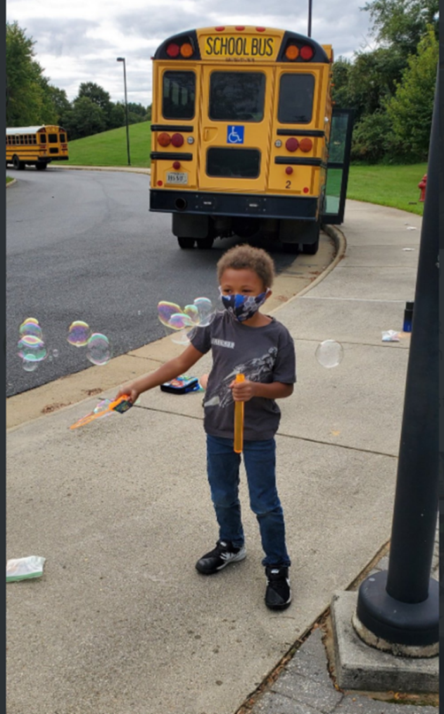
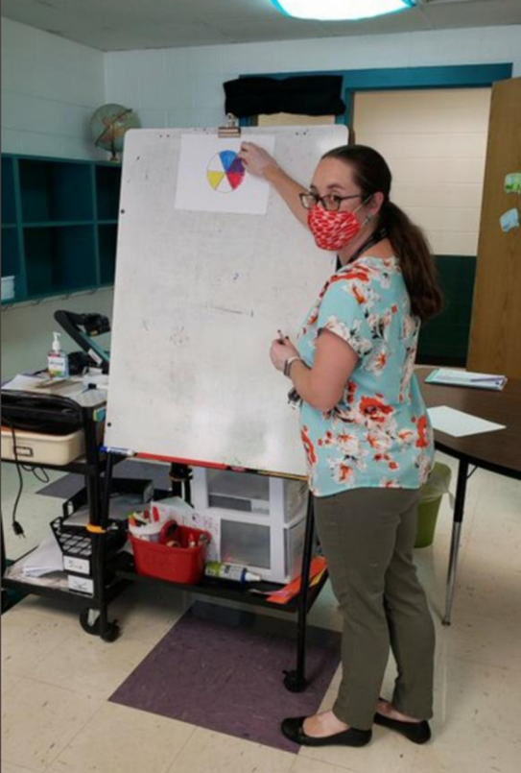

Revenues – Local
Fiscal Year | Local Funding County Funds | Local Funding Other Funds
2019-2020 | $17,465,112 | $1,198,000
2020-2021 | $17,465,112 | $494,000
County funds are the allocated funds from the county’s tax based revenue that are allocated to the schools
Other funds are comprised of funds from sources such as rents, regional programs, retiree insurance payments, insurance settlements, sale of equipment or the miscellaneous revenue. Note FY 20 actual for the category = $792,022

Slide 11

VRS Rates – Flat
 | FY 2021 | FY 2022
Employee Rate | 0.0500 | 0.0500
Employer Rate | 0.1662 | 0.1662
Retiree Health Care Credit (RHCC) | 0.0121 | 0.0121
Group Life Insurance (GLI) | 0.0134 | 0.0134
Total Employer Paid | 0.1917 | 0.1917
Health Insurance
Increase Estimated at 8-10% | $280,000-350,000
Impact: Claims experience has increases as well as increase in prescription drug/ pharmaceutical costs.

Slide 12
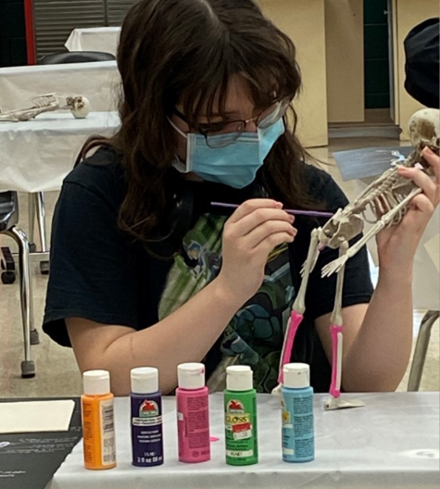

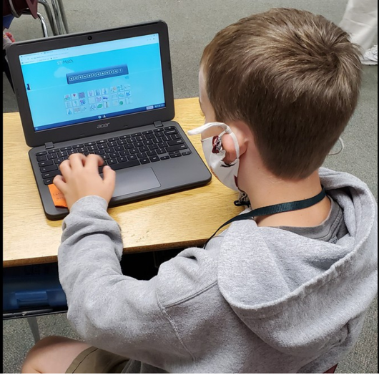
Expenditure Requests and Evaluation
Over a $850,000 in requests were submitted for consideration by schools and departments
Requests are outside and separate from existing mandates that are required.
Cover a broad spectrum of areas including personnel, learning supports, software and materials. Student supports are a priority.
Evaluated based on serving the growing diversity of student needs, alignment with strategic plan and efficient allocation and utilization of resources

Slide 13
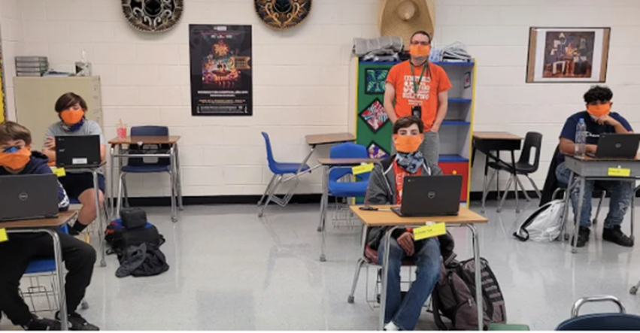
Salary Projections
Percentage | Increase
2% Increase | $491,722
3% Increase | $737,583
4% Increase | $983,444
Includes FICA and VRS
Teacher Retention and Hiring are key focus areas
Need to combat increased teacher shortages decreased talent pipeline. Recruiting environment is challenging with no in person job fairs
Continually evaluating compensation and incentives in all critical shortage areas

Slide 14
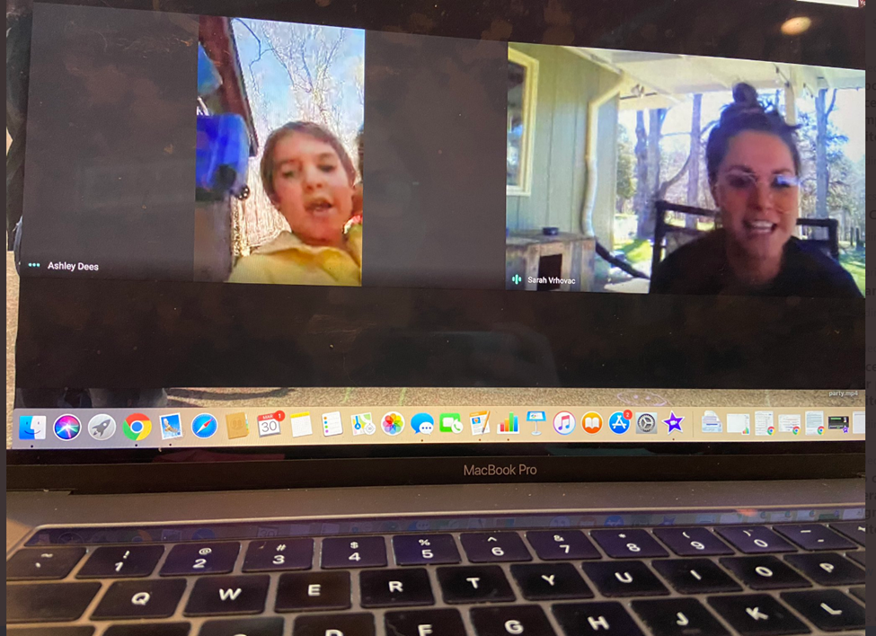
“When the untapped potential of a student meets the liberating art of a teacher, a miracle unfolds”
Dr. Mary Hatwood Futrell
Professor Emerita, Education Policy
The George Washington University

